Slide 1


Time and space complexity

Slide 2
Today’s Checklist
Time Complexity
Types of Time complexity Analysis
Space Complexity
Recurrence relations
Substitution method
Recurrence tree method
Master’s theorem

Slide 3
Time complexity

Slide 4
Types of time complexities
Worst case
Best case
Average case

Slide 5
Time complexity Example - 1
for (int i = 0; i < n; i++) {
// some operation of O(1) complexity
}

Slide 6
Time complexity Example - 2
for (int i = 0; i < n; i++) {
for (int j = 0; j < n; j++) {
// some operation
}
}

Slide 7
Time complexity Example - 3
int binarySearch(int[] arr, int x) {
int low = 0;
int high = arr.length - 1;
while (low <= high) {
int mid = (low + high) / 2;
if (arr[mid] == x) {
return mid;
} else if (arr[mid] < x) {
low = mid + 1;
} else {
high = mid - 1;
}
}
return -1;

Slide 8
Space complexity

Slide 9
Space complexity example -1
void printHello() {
String hello = "Hello, World!";
System.out.println(hello);
}

Slide 10
Space complexity example - 2
int[] copyArray(int[] arr) {
int[] copy = new int[arr.length];
for (int i = 0; i < arr.length; i++) {
copy[i] = arr[i];
}
return copy;

Slide 11
Space complexity example - 3
int f(int n){
if (n <= 0){
return 0;
}
return n + f(n-1);
}

Slide 12
Recurrence relations

Slide 13
Time complexity of recurrence relations
Substitution method
Recurrence tree method
Master’s theorem

Slide 14
Substitution method

Slide 15
Try this : T(n) = 2T(n/2) + 4n

Slide 16
Try this : Determine the recurrence relation for the following series 1,7,31,127,499.

Slide 17
Recurrence tree method

Slide 18
Try this : T(n) = 2T(n/2) + n^2

Slide 19
Try this : T(n) = T(n/3) + T(n/4) + kn

Slide 20
Master theorem

Slide 21
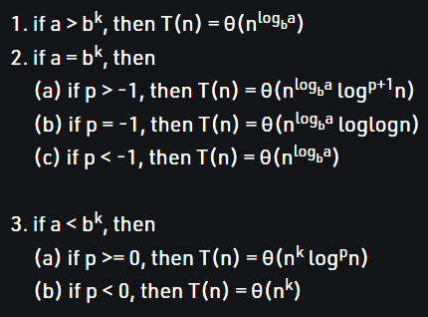
Different cases in master theorem

Slide 22
Try this : T(n) = 3T(n/5) + 5n^2

Slide 23
Try this : T(n) = 2T(2n/3) + 1

Slide 24
Summary

Slide 25
Next class teaser
Introduction to 1D Array
Palindrome in array
Reversing an array
Missing element in an array
Finding Duplicates in an array

Slide 26
THANK YOU

